Slide 1
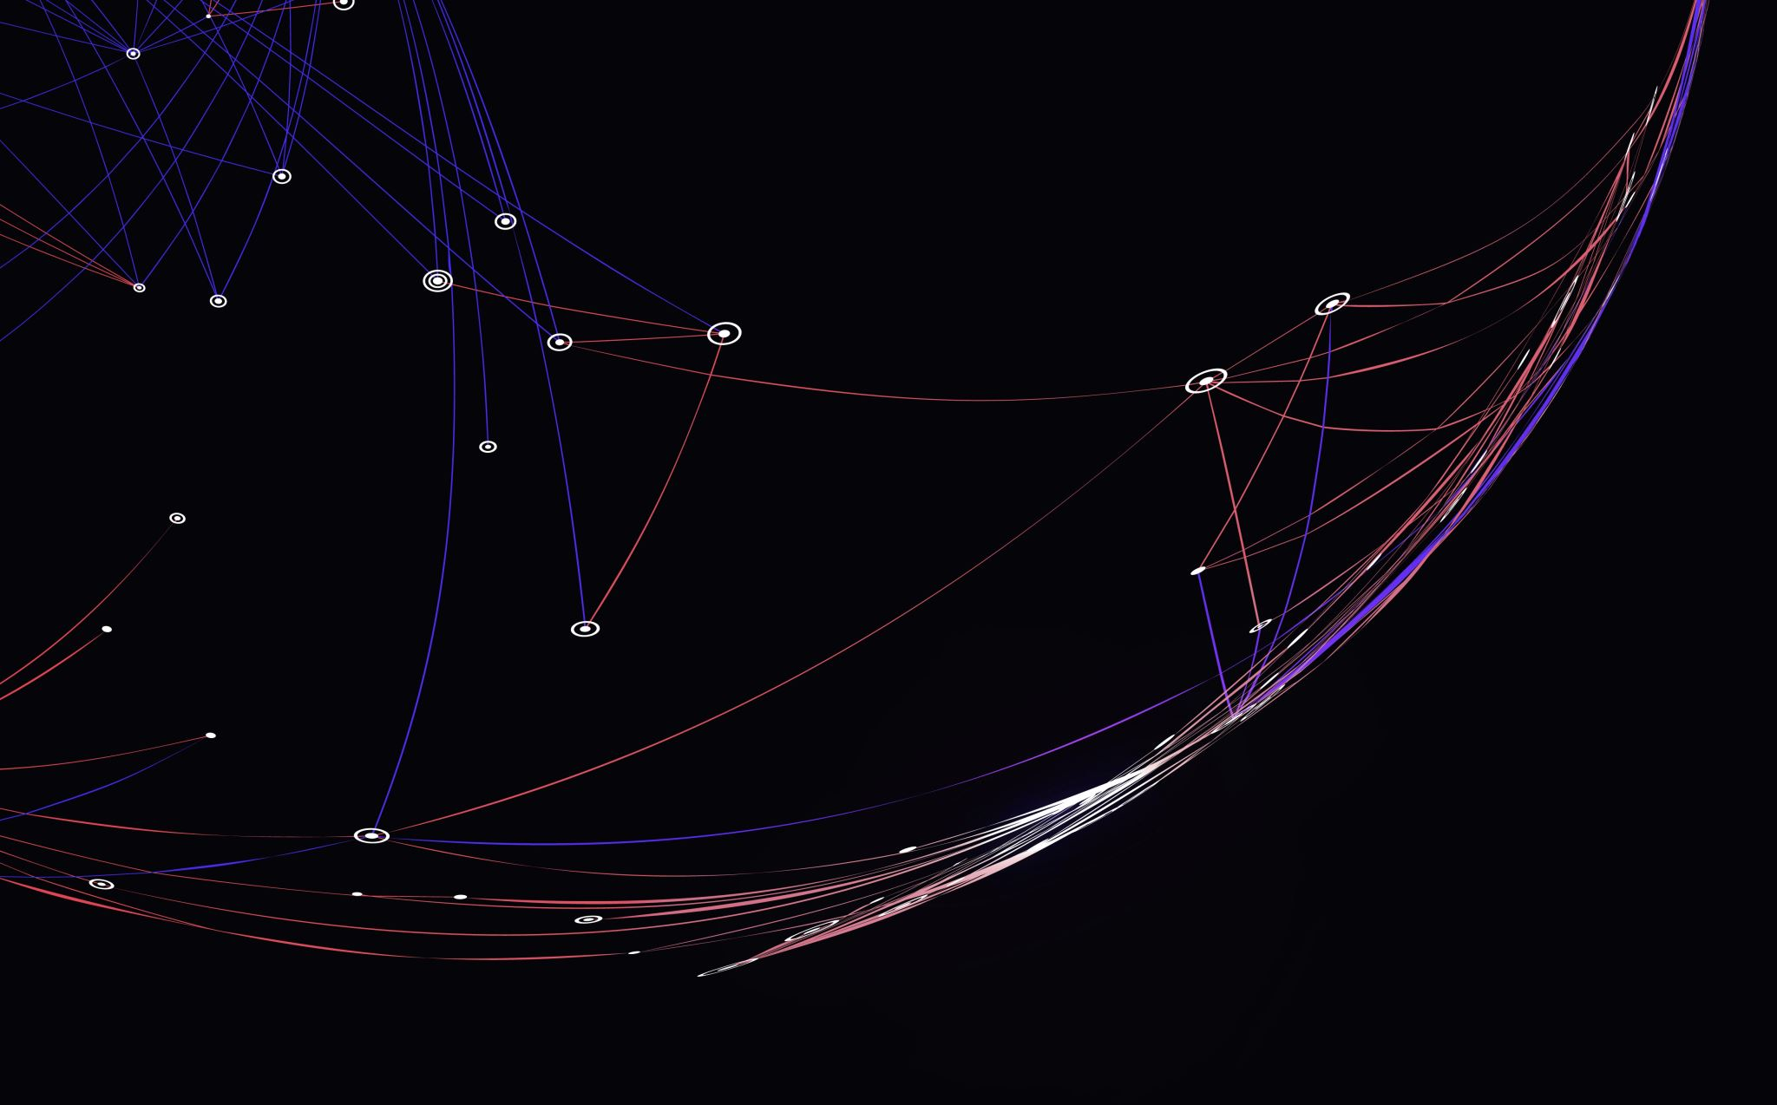
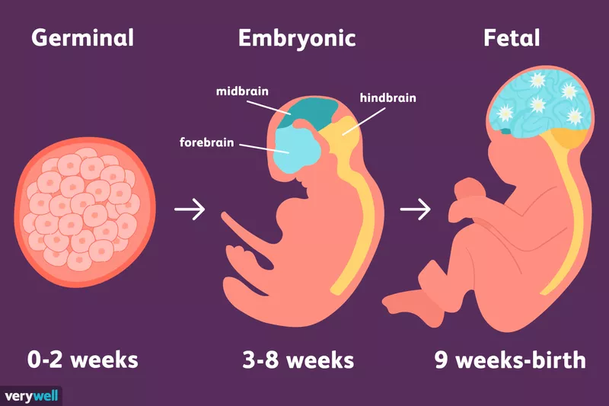
“Fetal Health Status Prediction Using Machine Learning Techniques”

Slide 2
Fetal Health INTRODUCTION
Anomalies affect 1–3% of the population and are most discovered during pregnancy.
About 60–70% of the abnormalities can be detected by CTG (cardiotocography), whereas the remaining 30–40% can be detected after birthing. About 96 women were processed as part of our experiment to predict prenatal anomalies.
Medical diagnosis and prediction are two topics that are intertwined in e-Health and machine learning.
Patients who are unable to see a doctor or other health professional would benefit greatly from e-Health software.
Using machine learning techniques and e-Health applications, we hope to assist physicians and families in better predicting fetal abnormalities than traditional prenatal tests.

Slide 3
Fetal Health classification
Preventing child and mother mortality through foetal health classification. Child mortality reduction is an important indication of human progress and is reflected in several of the United Nations' Sustainable Development Goals.
The fetal stage of human development begins nine weeks after fertilization (or eleven weeks gestational age) and lasts until birth. There is no single identifying trait that distinguishes an embryo from a fetus throughout prenatal development.

Slide 4
Problem statement
Understanding the cardiotocography can be used to monitor a baby's heart rate and a mother's contractions while the baby is in the uterus.CTG is used to monitor the infant for any signs of distress before and during childbirth.
By looking at various different aspects of the baby's heart rate, we can see the condition of a baby. The vast majority of these deaths (94%) happened in low-resource areas, and the majority of them could have been avoided.

Slide 5
OBJECTIVE
The major goal of this project is to create a prototype using different data processing approaches and the models that are used is Random forest, KNN, Support Vector Machine. Using machine learning techniques, the physicians and families can get better in predicting fetal congenital abnormalities than traditional pregnancy tests.

Slide 6
Dataset Description
The UN expects that by 2030, countries end preventable deaths of newborns and children under 5 years of age, with all countries aiming to reduce under‑5 mortality to at least as low as 25 per 1,000 live births.
Parallel to notion of child mortality is of course maternal mortality, which accounts for 295 000 deaths during and following pregnancy and childbirth (as of 2017).
This dataset contains 2126 records of features extracted from CTG, which were then classified by experts into 3 classes:
Normal
Suspect
Pathological

Slide 7
Variable description
Target variable: 'fetal_health' Tagged as 1 (Normal), 2 (Suspect) and 3 (Pathological)
Independent variables: baseline value: FHR baseline (beats per minute) accelerations: Number of accelerations per second fetal_movement : Number of fetal movements per second uterine_contractions: Number of uterine contractions per second light_decelerations: Number of light decelerations per second severe_decelerations: Number of severe decelerations per second prolongued_decelerations : Number of prolonged decelerations per second
abnormal_short_term_variability : Percentage of time with abnormal short term variability

Slide 8
Right Data for analysis
Understanding the data based on the research papers
We have cleaned the data based on the columns which are useful for the data analysis.
Reduced the data to (2126,10)

Slide 9
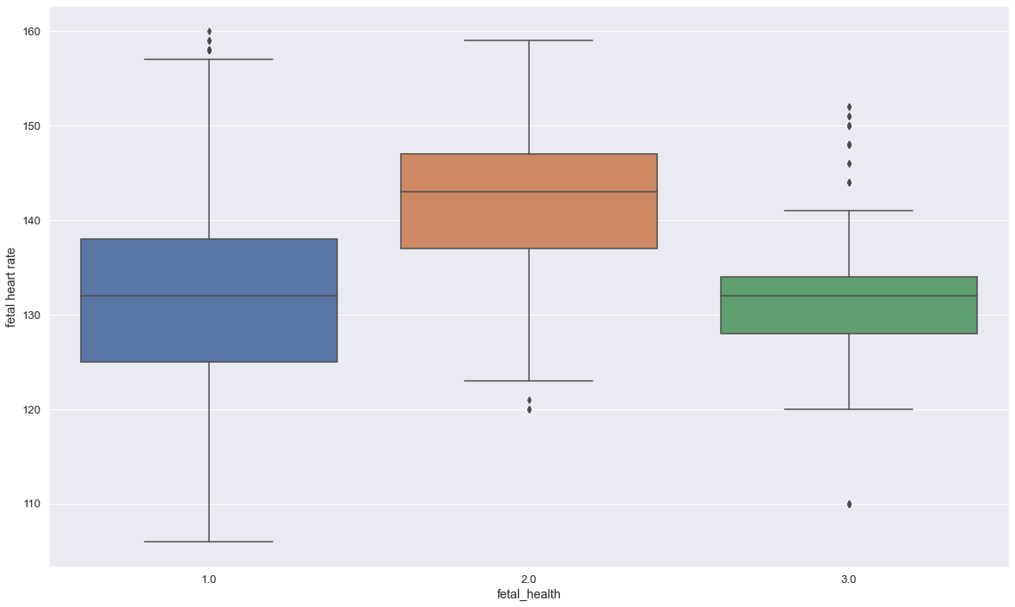
Insights/ interpretations
Identify the affected heart-beat Fluctuations by taking into consideration analysis of various factors like baseline value(Fetal Heart Rate per minute),fetal movements per second, uterine contractions per second.
In the above plot fetal health 2.0 has poor fetal heart rate which indicate babies health is not good
1.0 : Normal
2.0: Suspect
3.0: Pathological

Slide 10
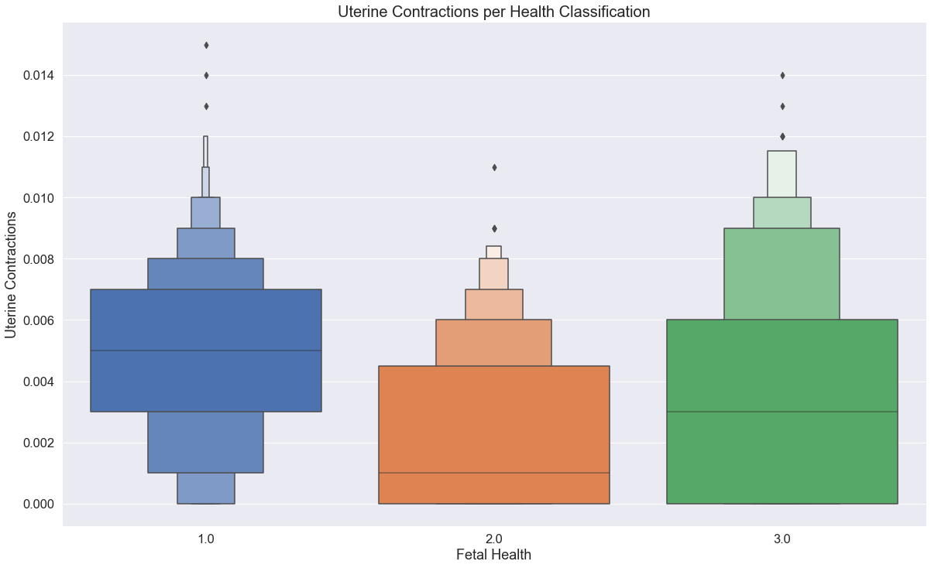
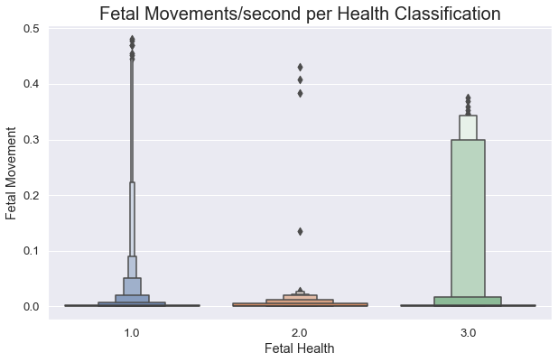
There doesn't seem to be a lot of variability among uterine contractions. There are more higher values for normal records.
There seems to more commonly be movements among records classified as pathological(3.0).

Slide 11
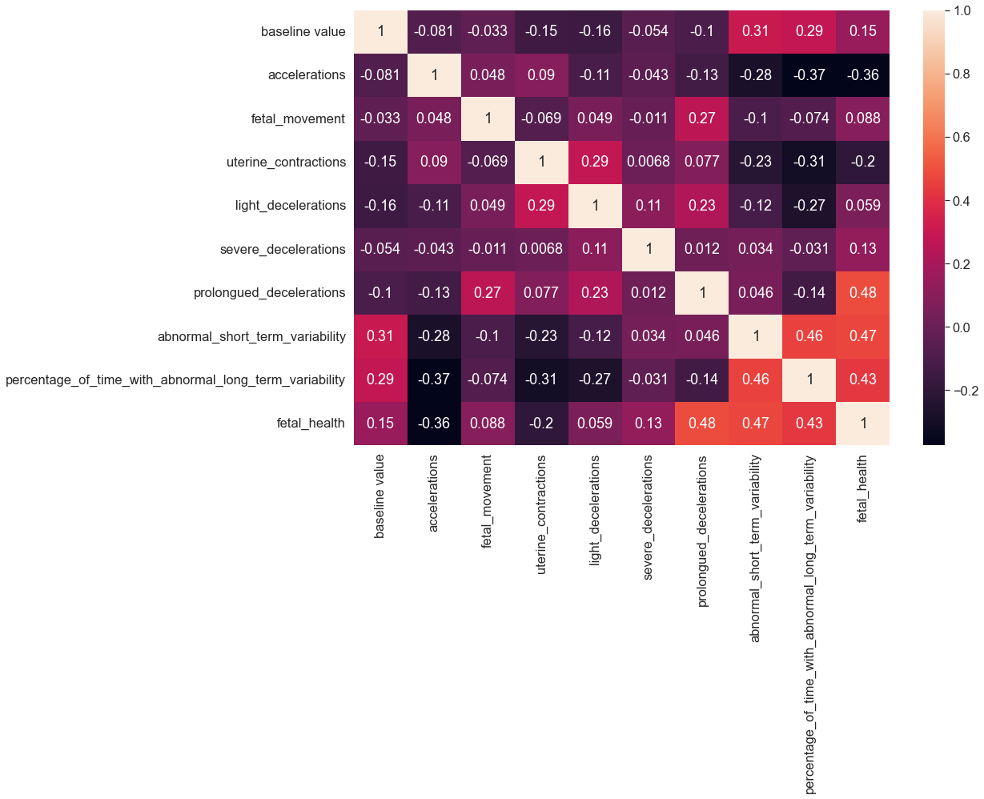
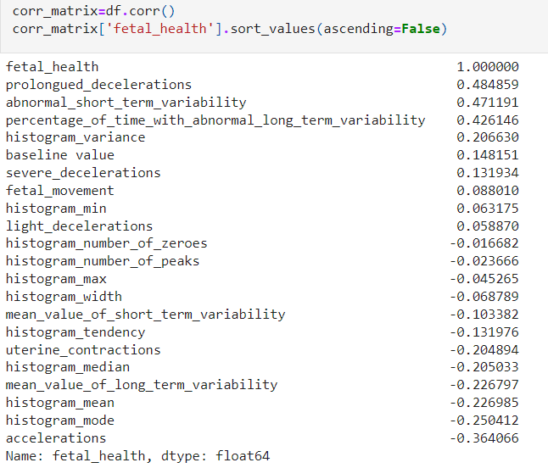
from the above table, there are some columns with negative correlation which are negligible.
Heatmap show the correlation matrix with positive correlation

Slide 12
Model BUILDING
In the model building we have used:
Random forest
KNN(k-nearest neighbour)
Naive Bayes
SVM(support vector machine)

Slide 13
Results
Model | Accuracy | percision | recallscore | f1score
RANDOM FOREST | 94.3% | 96% | 98% | 97%
K-Nearest Neighbors (KNN) | 89.4% | 84% | 78.8% | 81.1%
NAIVE BAYES | 79.1% | 68.3% | 75.3% | 69.2%
SVM | 84.7% | 79.2% | 61.8% | 67.4%
We have used four of these models for the fetal heart rate
Random forest is the best model which gave result with 94.3% accuracy.
Random forest model can be considered for fetal health classification.

Slide 14
Recommendations
‘Prevention is better than cure’, By knowing fetal health we can prevent baby from effecting any disease or complications.
We can reduce maternal mortality rate.
We can suggest healthy diet sheet for infants' health.
We can suggest physical exercise to improve mother and fetal health conditions.

